Slide 1

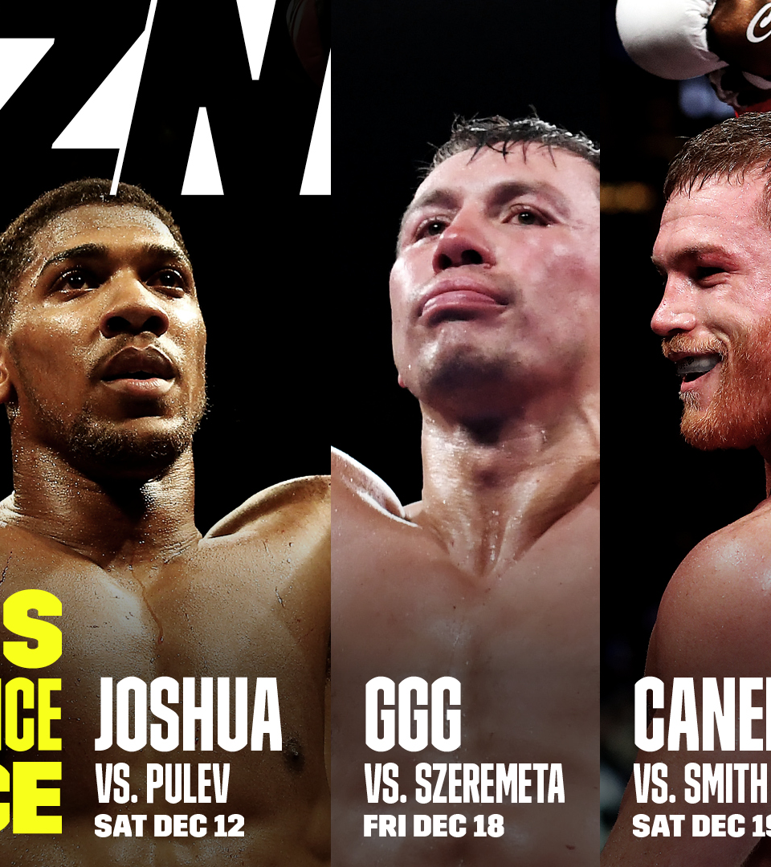
DAZN
By Logan Wright

Slide 2

Overview
DAZN: A global sports streaming service launched in 2016. Subscription-based sports streaming service.
Founder: Len Blavatnik, aiming to create the 'Netflix of sports’. Developed by Perform Group, UK.
Mission: Providing live, on-demand sports content ‘anytime, anywhere’.
Available in over 200 countries.
Content: Football, basketball, baseball, combat sports, motorsports.

Slide 3
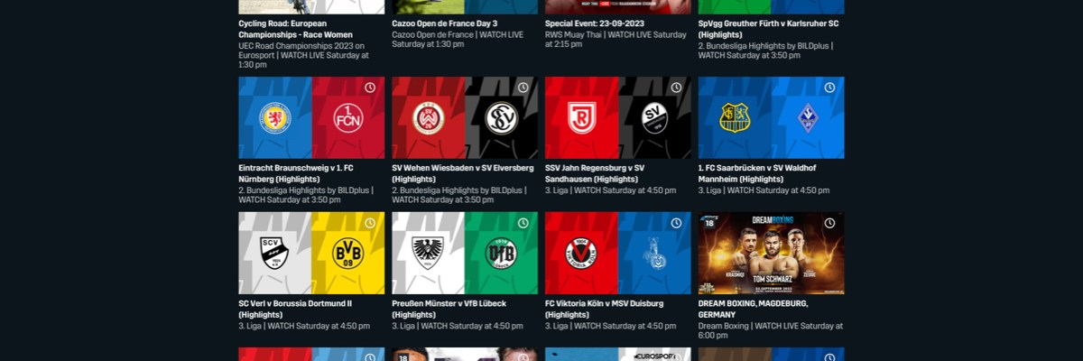
Market Position
Established presence in sports streaming.
Unique selling proposition: Streaming over traditional cable.
Accessible via smart TVs, smartphones, tablets, and gaming consoles.
Competes with ESPN+, Amazon Prime Video, and illegal streaming sites.

Slide 4
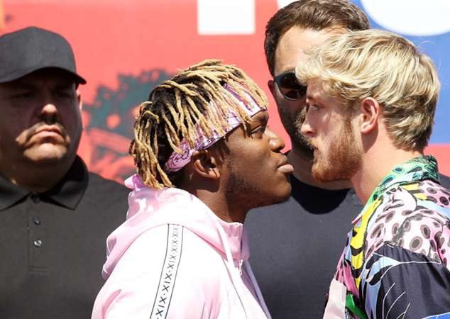
Challenges for DAZN
Competition: high competition from traditional sports networks and streaming platforms. Rising costs of exclusive broadcasting rights.
Revenue Streams: need to balance monetization without compromising viewer experience.
Market Penetration: establishing brand presence in new regions. Tailoring strategies to unique market preferences.

Slide 5

Opportunities for DAZN
Expansion: translating content into multiple languages. Entering new markets with tailored strategies.
Exclusive Broadcasting Rights: acquiring rights to popular sporting events. Creating exclusivity to attract subscribers.
Technological Investment: utilizing advanced streaming technology for high-quality service. Employing data analytics to understand viewer preferences.

Slide 6
Strategic Recommendations
Exclusivity:
Secure broader broadcasting rights. Develop high-quality original programming.
Invest in Technology:
Implement multi-angle viewing, real-time stats, and interactive elements. Ensure high-quality, reliable streaming service.
Leverage Partnerships:
Explore bundling opportunities with other services. Form strategic alliances with local sports leagues.
Personalize:
Use data analytics for personalized content recommendations. Develop community features and social integrations.

Slide 7
Con.
Revenue Streams:
Integrate targeted advertising and branded content partnerships. Offer tiered subscription models, including freemium options.
Strengthen Global Presence:
Produce localized content for different regions. Tailor marketing strategies to fit regional preferences.

Slide 8

The End

